Slide 1
Introduction to
Modern Symmetric-key
Ciphers
5.<number>
Copyright © The McGraw-Hill Companies, Inc. Permission required for reproduction or display.

Slide 2
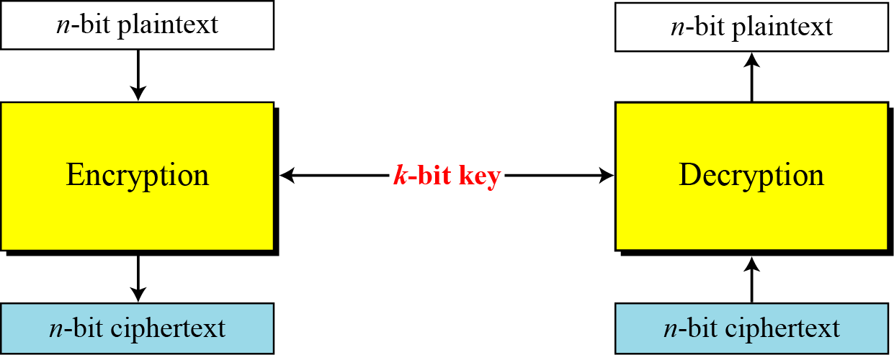
5.1 Continued
Figure 5.1 A modern block cipher
5.<number>

Slide 3
5.1 Continued
Example 5.1
How many padding bits must be added to a message of 100 characters if 8-bit ASCII is used for encoding and the block cipher accepts blocks of 64 bits?
Solution
Encoding 100 characters using 8-bit ASCII results in an 800-bit message. The plaintext must be divisible by 64. If | M | and |Pad| are the length of the message and the length of the padding,
5.<number>

Slide 4

5.1.1 Substitution or Transposition
A modern block cipher can be designed to act as a substitution cipher or a transposition cipher.
Note
To be resistant to exhaustive-search attack,
a modern block cipher needs to be
designed as a substitution cipher.
5.<number>

Slide 5
Fundamental Cryptographic Principles
Messages must contain some redundancy
Some method is needed to foil replay attacks

Slide 6
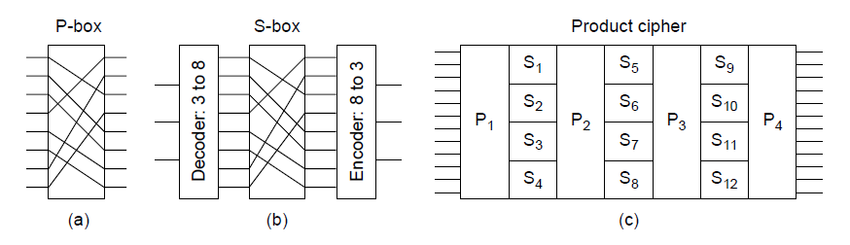
Symmetric-key Algorithms (1)
Basic elements of product ciphers.
(a) P-box. (b) S-box. (c) Product.

Slide 7
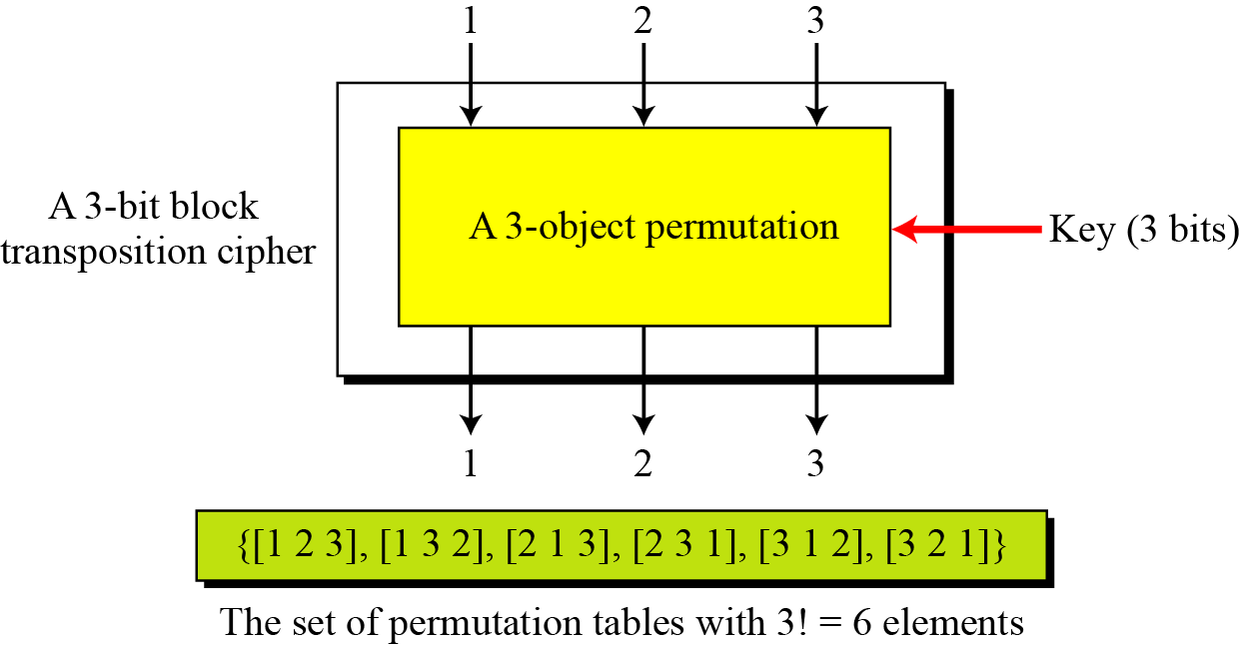
P-Box
Figure 5.2 A transposition block cipher modeled as a permutation
5.<number>

Slide 8

Table 6.3 shows the permutation for S-box 1. For the rest of the boxes see the textbook.
Table 6.3 S-box 1
6.<number>

Slide 9
Example 6.3
The input to S-box 1 is 100011. What is the output?
Solution
If we write the first and the sixth bits together, we get 11 in binary, which is 3 in decimal. The remaining bits are 0001 in binary, which is 1 in decimal. We look for the value in row 3, column 1, in Table 6.3 (S-box 1). The result is 12 in decimal, which in binary is 1100. So the input 100011 yields the output 1100.
6.<number>

Slide 10
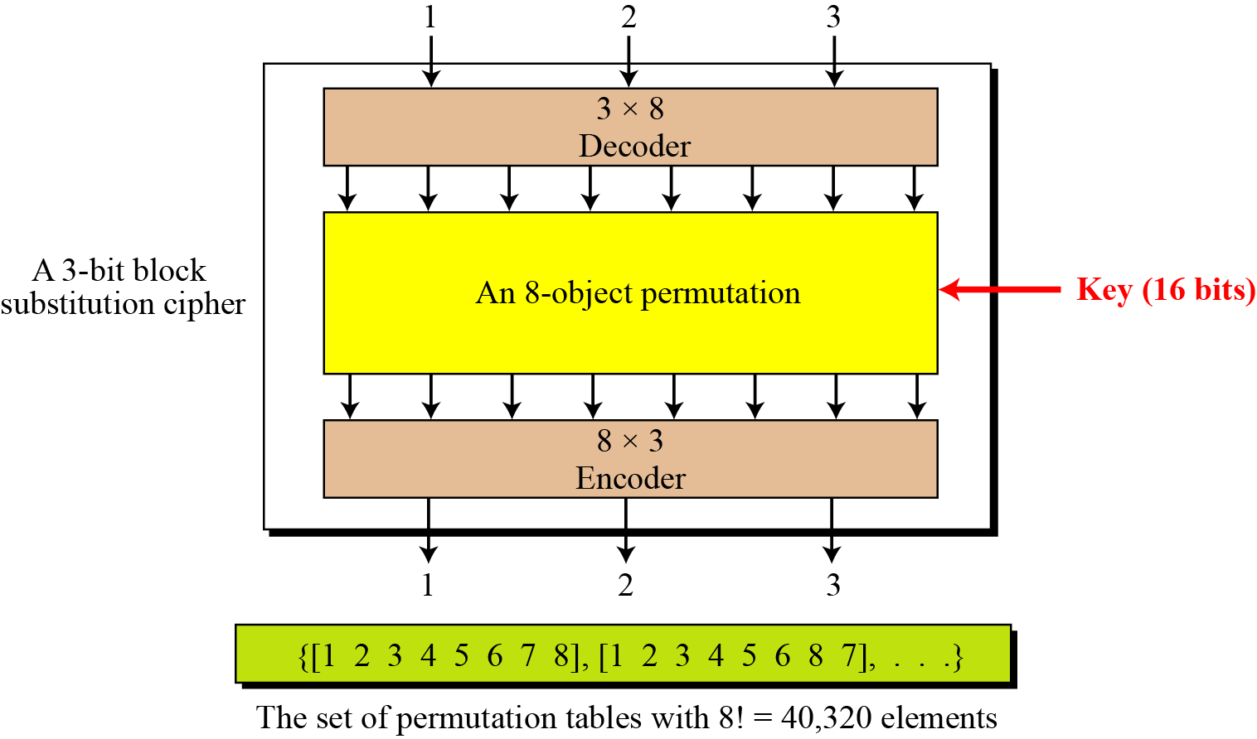
Figure 5.3 A substitution block cipher model as a permutation
5.<number>

Slide 11

Figure 6.2 General structure of DES
6.<number>

